Slide 1

Optimizing the Gold Membership Drive: Data Driven Strategies for Targeted Campaigning
Consulting Team:
Ganesh Apparaju
Zoya Faiz
Sai Karun Reddy Gaddam
Minghao Liu
Xuanyu Wang
ML Notebooks
Notes:
ML Notebooks - Link : takes you to the code files for all the Machine Learning models we ran for this project

Slide 2





MEET OUR TEAM
Sai Karun
Pierce
Zoya
Ganesh
Charlotte

Slide 3
Content
Metrics for Business
Data Understanding & Preparation
Modeling
Business Understanding
Addressing Business Challenges
Evaluation
Deployment

Slide 4

What are we solving?
Client Domain : Retail Super Store
The Superstore wants a solution to identify potential customers who would sign up for the Gold Membership when pursued through the tele-marketing channel
Notes:
Super store wants to target potential customers who would buy the gold membership when approached through telemarketing

Slide 5
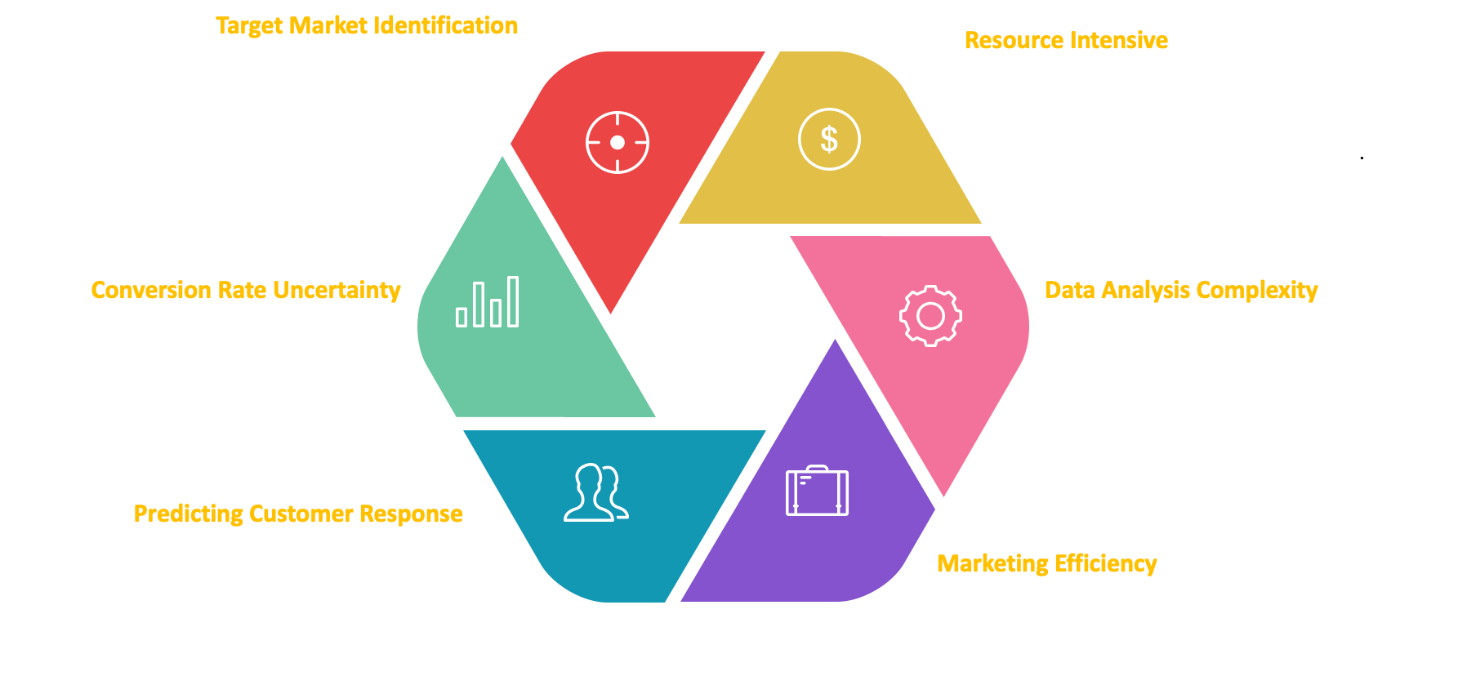
BUSINESS PROBLEM
Notes:
Problems that the superstore currently face are: 1. Difficulty in pinpointing the potential buyers for the gold membership, 2. Unable to predict the customer response - which might lead to wasted investment, 3. It is tough and very costly to reach out to every customer for the membership drive, 4. Unable to analyse and utilise existing customer data, 5. It is difficult to achieve efficient targeted marketing, ;;;; finally all these might lead to 6. Low subscription uptake - which would effect campaign success

Slide 6

Addressing Business Challenges through Data Mining
Precision Targeting:
Focus on high-likelihood customers to increase campaign precision and reduce wasteful spending
Customer Behavior Insights:
Utilize historical data to understand purchasing patterns, driving more engaging and relevant offers
Cost & Revenue Balance:
Employ predictive analytics to lower campaign costs while identifying upsell opportunities for revenue growth
Data Driven Loyalty Programs:
Enhance long-term customer relationships through personalized promotions based on data-driven insights
Resource Efficacy:
Optimize marketing budgets and manpower by prioritizing efforts on segments predicted to yield high response rates
Strategic Growth:
Leverage predictive modeling to formulate strategies that cater to evolving customer needs, ensuring sustained business growth
Notes:
With the Data Mining solutions, store will be able to perform : 1. Targeted Marketing to reach out to potential buyers and reduce wasteful spending, 2. They can analyse customer behavior to offer them relevant deals, 3. It is able to lower costs and improve revenue with the predictive analytics, 4. Super store can offer personalized promotions to customers with the insights, 5. They can optimise their marketing budget with precision marketing, 6. Leveraging all these they can achieve business growth.

Slide 7
Choosing Right Metric for the Business
TARGET VARIABLE : RESPONSE
F1 Score Focus: Key for balancing false positives and negatives, enhancing model reliability
Recall Emphasis: Targets reducing false negatives to avoid missing potential customers
Comparative Impact: False negatives more critical than false positives in customer acquisition
Business Relevance: Aligns with goals of effective marketing and cost-efficient campaigns
Notes:
For this business, we considered F1 score as the metric as both FN and FP would affect the business in a badway. But out of them, we gave more importance to Recall as we feel that missing potential customers for the membership drive would lead to more loss compared to reaching out to few people who would not sign up for the membership.

Slide 8

Data Understanding & preparation

Slide 9
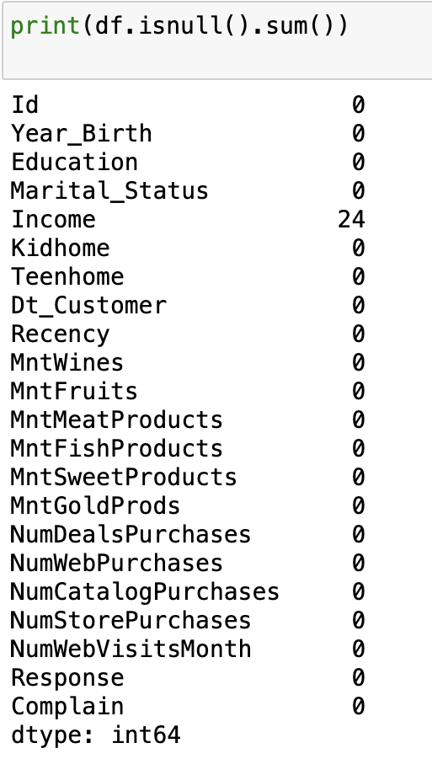
Data Preparation : Nulls
We have nulls only for Income attribute.
Since there are only a few nulls in a large dataset, it is the best if we just drop them
We have nulls only for Income attribute.
Process to replace nulls:
Average of Income for dataset: 52247
Average (for response = 1) = 60209
Average (response = 0) = 50839
Out of the 24 null values, 23 entries have Response = 0.
So, replaced those 23 nulls with 50839
And the null with Response = 1 with 60209
Average after replacement: 52236

Slide 10
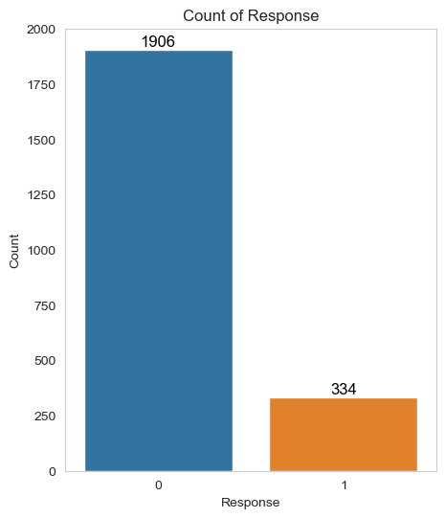
Data preparation : Oversampling
Response = ‘1’ accounts for 15% of the customers
Data set appears to be imbalance
Response Response
0 0.847924 0 0.76948
1 0.150271 1 0.307628

Slide 11
Data Preparation : Categorical Columns & more
Categorical Columns: encoding
Education, Marital_Status--> dummies_df (0 or 1)
Combine:
Overall Frequency ( ∑Number of purchase )
Avg Order Value ( ∑Amount spent on good / OvrFrequency)
pct_income_spent (Avg Order Value / Income)
Deals Per Purchase (NumDealsPurchases / Overall Frequency)
Date time conversion:
Dt_Customer: (6/16/2014, 6/15/2014…) --> days_enrolled

Slide 12
Data preparation: Standardization
Since there are binary and numerical columns with wide ranges, standardization is needed for more accurate prediction
Income Kidhome Teenhome MntWines
min 4428.0 0 0 0
max 666666.0 2 2 1493

Slide 13
Modelling
Logistic Regression
Decision Tree
Random Forest
Gradient Boosting
KNN
Neural Network
XGBoost
Support Vector

Slide 14
Which is the Winning Model?
Models | Precision | Recall | F1 Score
Logistic Regression | 71% | 59% | 78%
Random Forest | 89% | 83% | 89%
KNN | 79% | 82% | 84%
XGBoost | 86% | 83% | 88%
Decision Tree | 77% | 80% | 82%
Gradient Boosting | 89% | 86% | 91%
Neural Networks | 79% | 54% | 76%
SVM | 83% | 87% | 88%

Slide 15
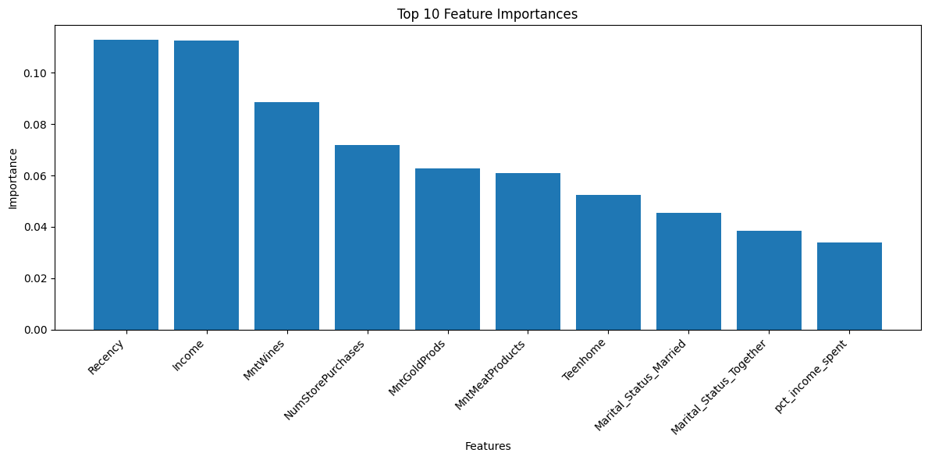
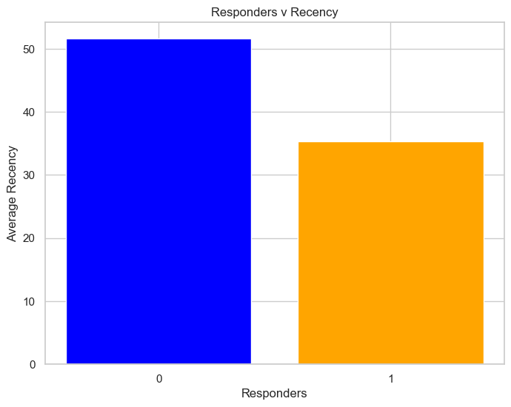
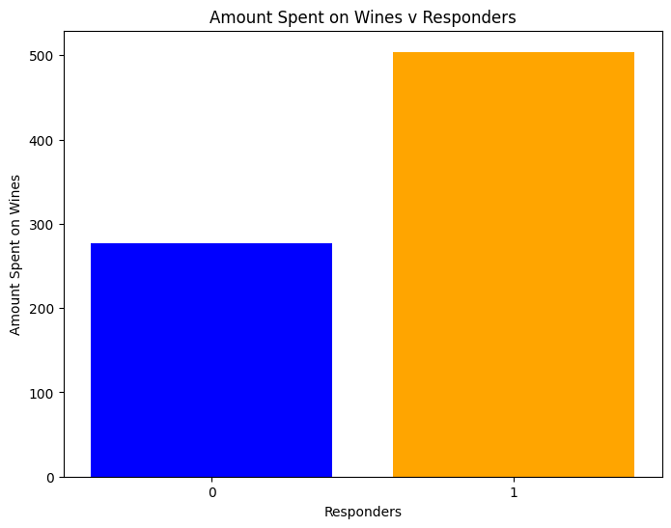
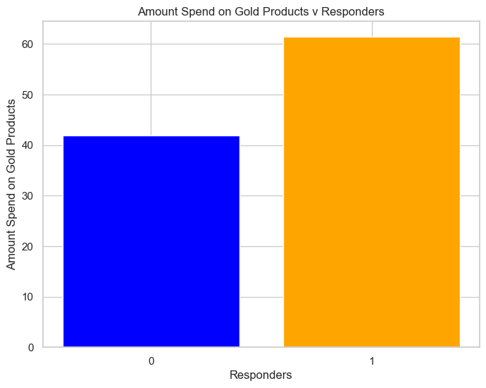
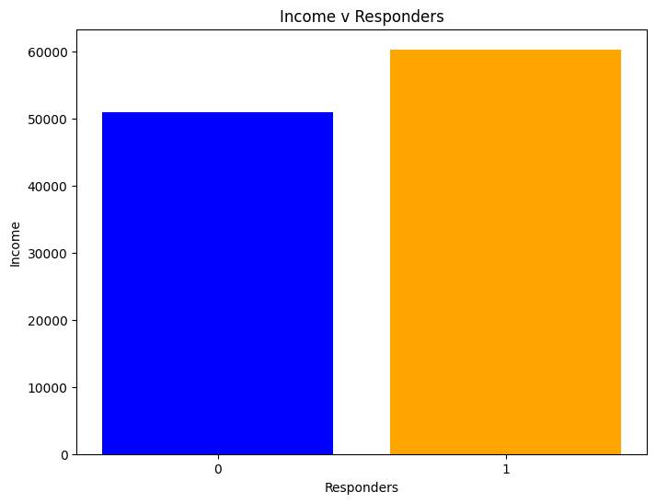
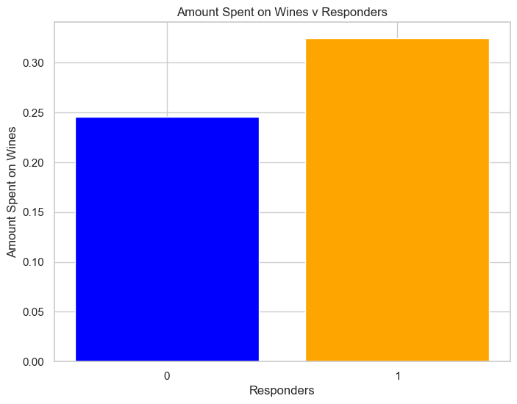
The model says… most Recent, Frequent and Monetary customers are most likely to respond
Notes:
We'll navigate through the challenges and solutions in deploying our winning model. First, we'll cover the critical aspect of data privacy and compliance, emphasizing our strict adherence to regulations and secure data practices. Next, the focus shifts to mitigating model bias, highlighting our commitment to fairness through regular assessments and the utilization of diverse data sets. We'll also discuss the importance of adapting to changing customer behaviors, ensuring our model stays relevant by incorporating the latest market trends. Additionally, it's crucial to strike a balance between relying on model predictions and human judgment, ensuring our sales team leverages data insights without becoming overly dependent on them. Lastly, we delve into the technicalities of integrating this model into our existing systems, outlining the collaborative efforts with IT professionals and our strategy for a phased, problem-solving-focused rollout. This holistic approach guarantees not only the technical success of our model but also aligns with our ethical standards and business objectives.

Slide 16
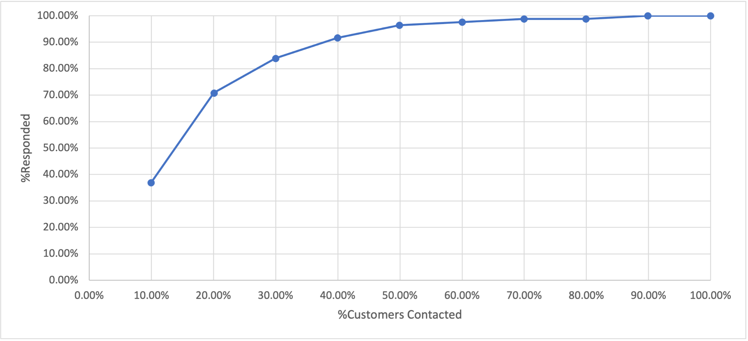
By contacting top 40% percent of customers we can reach out to 90% of most probable responders leading higher efficiency in campaign targeting
Gain Chart
Notes:
We'll navigate through the challenges and solutions in deploying our winning model. First, we'll cover the critical aspect of data privacy and compliance, emphasizing our strict adherence to regulations and secure data practices. Next, the focus shifts to mitigating model bias, highlighting our commitment to fairness through regular assessments and the utilization of diverse data sets. We'll also discuss the importance of adapting to changing customer behaviors, ensuring our model stays relevant by incorporating the latest market trends. Additionally, it's crucial to strike a balance between relying on model predictions and human judgment, ensuring our sales team leverages data insights without becoming overly dependent on them. Lastly, we delve into the technicalities of integrating this model into our existing systems, outlining the collaborative efforts with IT professionals and our strategy for a phased, problem-solving-focused rollout. This holistic approach guarantees not only the technical success of our model but also aligns with our ethical standards and business objectives.

Slide 17

Projected Outcome:
Costs | Before | After
Total Customers contacted | 100 | 40
Total Responders | 18 | 16
Amount spent per offer | $ 500 | $ 500
Total Investment | $ 50,000 | $ 20,000
$ 30,000
Deploying the data mining solution, we propose store would incur savings of $ 30000 in costs compared to earlier, per 100 randomly selected customers

Slide 18
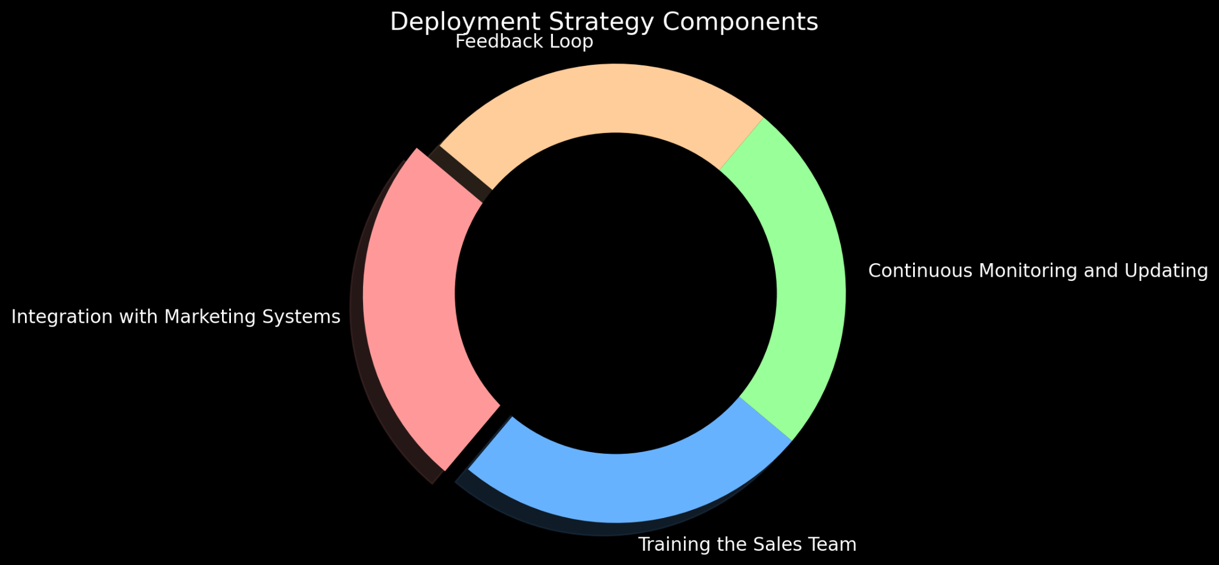
Model Deployment Strategy
Notes:
in this part, we'll explore the key components of our Deployment Strategy for the predictive model, aimed at enhancing our year-end sales campaign. Firstly, we're integrating the model with our CRM systems for more effective customer targeting. Secondly, we're emphasizing the importance of training our sales team to understand and utilize the model's insights for better customer engagement. Thirdly, continuous monitoring and updating of the model are crucial to maintain its accuracy and relevance in a dynamic market. Lastly, we're establishing a feedback loop with our sales team to refine the model based on real-world experiences and responses. Each of these components is vital to the success of our deployment strategy, ensuring our campaign is both effective and efficient.

Slide 19
Potentials Issues & Mitigation
- Data Privacy and Compliance
- Model Bias and Fairness
- Changing Customer Behavior
- Over-reliance on Model Predictions
- Technical Integration Challenges
Notes:
We'll navigate through the challenges and solutions in deploying our winning model. First, we'll cover the critical aspect of data privacy and compliance, emphasizing our strict adherence to regulations and secure data practices. Next, the focus shifts to mitigating model bias, highlighting our commitment to fairness through regular assessments and the utilization of diverse data sets. We'll also discuss the importance of adapting to changing customer behaviors, ensuring our model stays relevant by incorporating the latest market trends. Additionally, it's crucial to strike a balance between relying on model predictions and human judgment, ensuring our sales team leverages data insights without becoming overly dependent on them. Lastly, we delve into the technicalities of integrating this model into our existing systems, outlining the collaborative efforts with IT professionals and our strategy for a phased, problem-solving-focused rollout. This holistic approach guarantees not only the technical success of our model but also aligns with our ethical standards and business objectives.

Slide 20
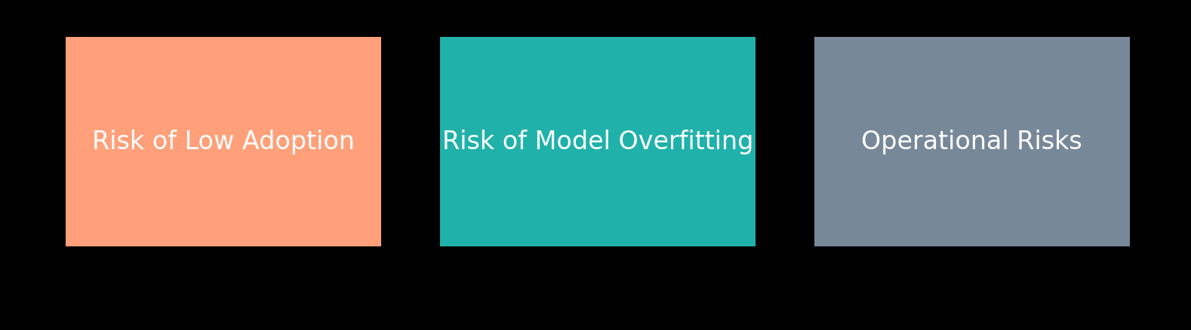
Risks Management & Mitigation
Notes:
We delve into three crucial risks associated with the deployment of our predictive model. Firstly, we address the "Risk of Low Adoption," highlighting the importance of engaging customers effectively to ensure they understand and see the value in our gold membership offer. Secondly, the "Risk of Model Overfitting" is discussed, underscoring our commitment to developing a robust model that generalizes well to unseen data, not just the data it was trained on. Lastly, we focus on "Operational Risks," emphasizing our proactive approach in identifying and mitigating potential technical or logistical challenges during the model's deployment. This slide aims to assure stakeholders of our thorough risk assessment and management strategies, ensuring a smooth and successful implementation of our predictive model.

Slide 21





Conclusion
Effective Data Utilization
Key Feature Identification
Promising Model Accuracy
Cost Effective Approach
Continuous Improvement
Notes:
In this concluding slide, we highlight the success of our project. We effectively harnessed a rich dataset to classify customers and identified key features, including income, recency, and spending, as influential factors in customer response. Our model shows promising accuracy, enabling us to efficiently target receptive customers while maintaining a cost-effective approach by focusing on existing customers. Furthermore, we emphasize our commitment to continuous improvement, ensuring adaptability to evolving customer behavior for sustained success……thank you

Slide 22
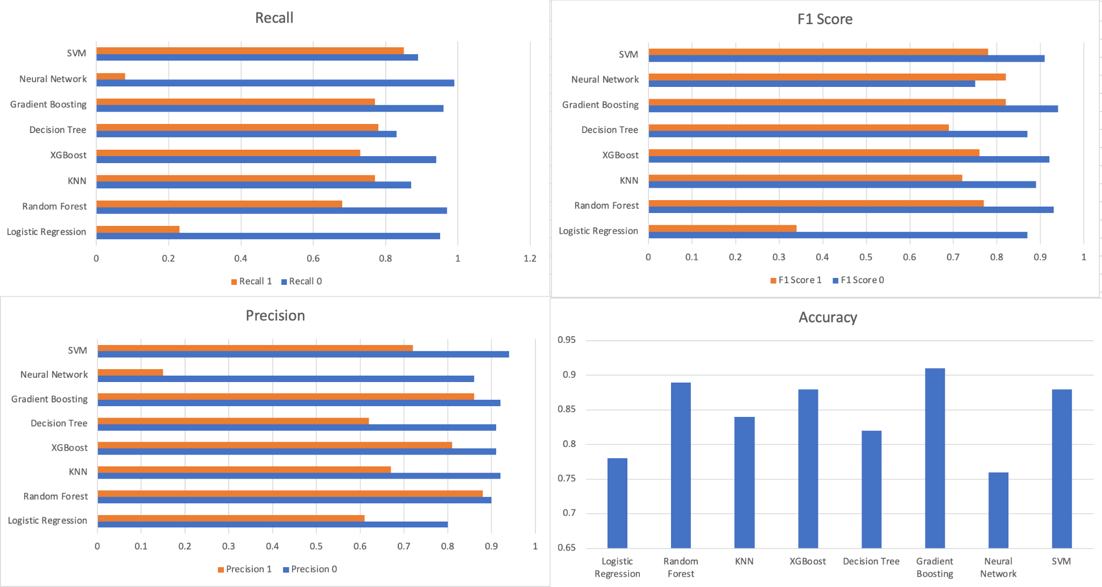
Gradient Boosting is the Winner!

